Slide 1
MICROSOFT CLARITY presentation by- Amandeep rewani

Slide 2
INTRODUCTION
This Presentation presents an analysis of user interactions within an application using Microsoft Clarity. The objective was to identify the most clicked-on features by users, enabling us to optimize feature usage and enhance user experience. Through comprehensive research, setup, data collection, and analysis, valuable insights have been derived to inform decision-making and improve the application's effectiveness.

Slide 3
Research on Microsoft Clarity
Microsoft Clarity is a robust analytics tool designed to capture user interactions on web pages. It offers features such as session recordings, heatmaps, and click tracking, providing deep insights into user behavior. Clarity's capabilities empower businesses to understand user engagement and optimize their digital experiences effectively

Slide 4
Key Features of Microsoft Clarity:
Session Recordings:
Provides recorded sessions of user interactions on the website, allowing playback to observe user behavior in real-time.
Enables in-depth analysis of individual user sessions to identify pain points, usability issues, and opportunities for improvement.
Heatmaps:
Visualizes user interaction data through heatmaps, highlighting areas of high and low user engagement on web pages.
Helps identify popular sections of the website, areas of interest, and potential optimization opportunities.
Click Tracking:
Tracks user clicks on various elements within web pages, including buttons, links, and navigation menus.
Offers insights into which features are most frequently used by users and which elements may require optimization.

Slide 5
4. Scroll Maps:
Displays scroll depth data to visualize how far users scroll down on web pages.
Helps identify content visibility and engagement levels, informing content placement and layout decisions.
5. Rage Clicks Detection:
Detects instances where users repeatedly click on the same element in frustration, indicating potential usability issues.
Alerts website owners to areas of the website that may require optimization or fixing to improve user experience.
6. Dead Clicks Analysis:
Identifies clicks on non-clickable elements or areas that do not trigger any action.
Helps pinpoint usability issues and areas where user expectations are not met, guiding optimization efforts.

Slide 6
Setup and Configuration
The setup process for Microsoft Clarity involved:
1. Sign Up and Log In:
Visit the Microsoft Clarity website and sign up for an account using your Microsoft credentials.
Once signed up, log in to your account to access the Clarity dashboard.
2. Create a New Project:
In the Clarity dashboard, navigate to the "Projects" tab and click on "Create New Project."
Provide a name for your project and enter the URL of the website you want to track.
3. Generate Tracking Code:
After creating a project, Microsoft Clarity will generate a unique tracking code snippet for your website.
Copy the tracking code snippet provided.

Slide 7
4. Insert Tracking Code into Website:
Access the source code of your website.
Paste the tracking code snippet generated by Clarity just before the closing </head> tag on every page of your website.
5. Verify Tracking Implementation:
Once the tracking code is inserted, navigate back to the Clarity dashboard.
Verify that the tracking code is successfully implemented by checking for the green checkmark next to your project name.
6. Monitor Dashboard:
Once setup is complete, monitor the Clarity dashboard regularly to view real-time data on user interactions, heatmaps, session recordings, and other analytics metrics.
7. Continuous Optimization:
Continuously analyze the data collected by Microsoft Clarity to identify patterns, optimize website features, and improve user experience.
Iterate on your setup and configuration based on insights gathered from Clarity analytics to enhance tracking accuracy and effectiveness.

Slide 8
Data Analysis
Upon successful setup, data on user interactions was collected and analyzed. The analysis involved:
Determining the most clicked-on features/buttons by users.
Examining user engagement patterns through heatmaps and session recordings.
Identifying trends and anomalies to gain insights into user behavior.
I Used Microsoft clarity for my application Employee Management System in which add employee button received the highest number of clicks and then edit button received the second highest number of clicks.

Slide 9

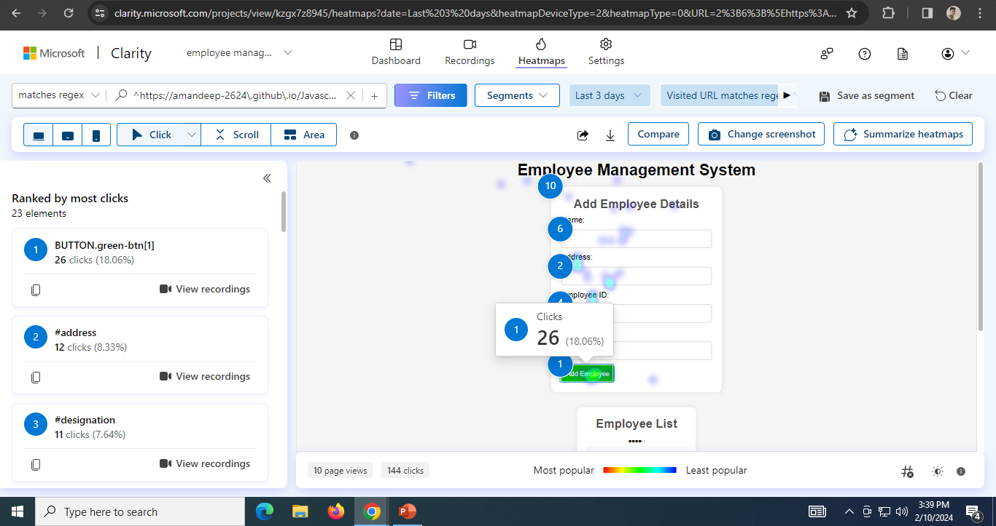
Here are screenshots of heatmaps of the parameters which help in analyzing the data.

Slide 10
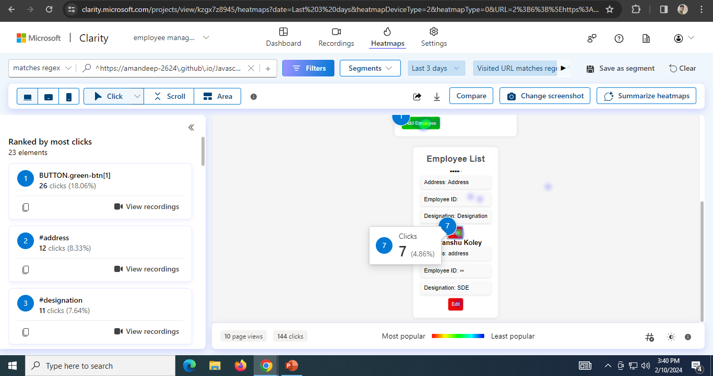

Slide 11
Most Frequently Used Features:
Add Employee Button: This feature receives the highest number of clicks, indicating that adding new employees is a frequent task for users.
Edit Button: Following the "Add Employee" button, the "Edit" button receives the next highest number of clicks. This suggests that users frequently engage with editing employee information.

Slide 12
User Engagement Patterns:
Frequency of Additions and Edits: The high click rates on the "Add Employee" and "Edit" buttons indicate that users frequently perform these actions. This pattern suggests a dynamic workforce environment where new employees are added and existing employee information is regularly updated.
Consistency in Feature Usage: The consistent engagement with these features underscores their importance in the user workflow. Users are likely to rely heavily on these functionalities for managing employee data.

Slide 13
Recommendations for Optimizing Feature Usage:
Streamline Employee Addition Process: Since the "Add Employee" button is heavily utilized, consider optimizing the employee addition process to make it more efficient and user-friendly. This could involve pre-populating certain fields, implementing auto-saving functionality, or providing clear guidance throughout the process.
Enhance Editing Experience: Given the significant engagement with the "Edit" button, prioritize enhancing the editing experience for users. This may involve implementing inline editing features, enabling bulk editing capabilities, or providing quick access to commonly edited fields.
Regular Updates and Maintenance: Continuously monitor user engagement patterns and gather feedback to inform ongoing updates and maintenance efforts. Regularly review and optimize the employee management system based on evolving user requirements and usage trends.

Slide 14
User Behavior Analysis
1: Rage Clicks: Rage clicks occur when users repeatedly click on an element out of frustration, often due to unresponsive or malfunctioning features.
Impact: High instances of rage clicks may indicate usability issues or technical glitches that need to be addressed.
Analysis: Identify pages or features where rage clicks are prevalent to pinpoint areas requiring immediate attention for optimization.
2: Dead Clicks: Dead clicks refer to clicks on non-clickable elements or areas that do not trigger any action.
Significance: Dead clicks can frustrate users and disrupt their workflow, leading to a poor user experience.
Analysis: Identify pages or elements where dead clicks occur frequently to assess usability issues or misalignment with user expectations.
3: Excessive Scrolling: Excessive scrolling indicates users' need to navigate through extensive content or pages with inadequate information hierarchy.
Impact: Excessive scrolling may lead to user fatigue and diminish engagement, impacting overall user satisfaction.
Recommendation: Implement strategies such as content reorganization, pagination, or lazy loading to reduce scrolling and improve content accessibility.

Slide 15
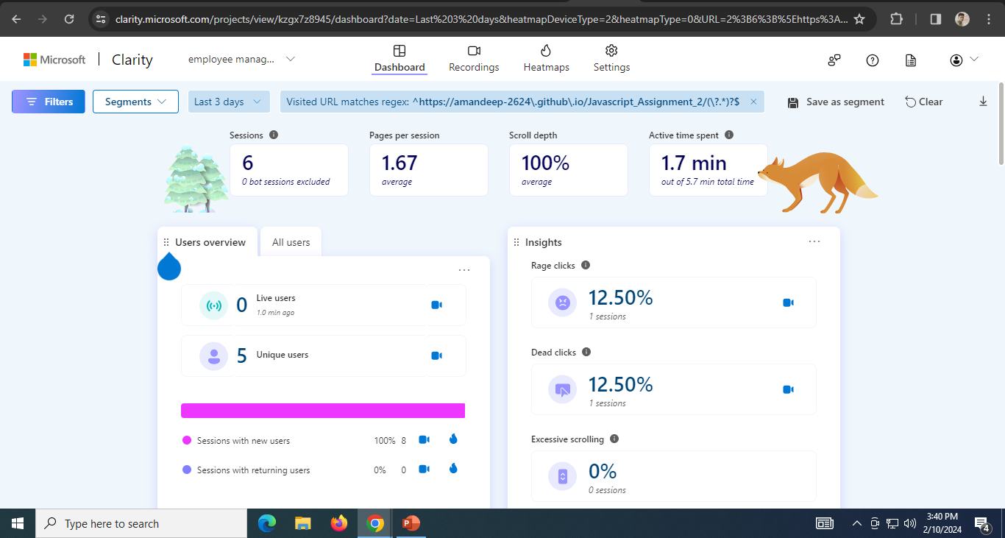
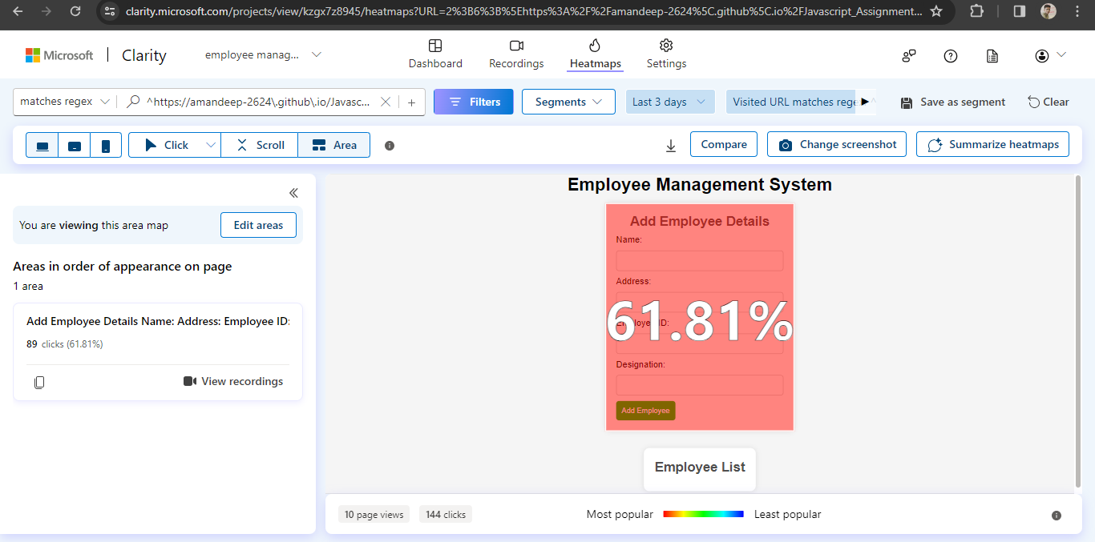
Analysis of Rage clicks, dead clicks and excessive scrolling
Area which appears most in the page i.e. 61.81%.

Slide 16
Conclusion
In conclusion, the utilization of Microsoft Clarity for the analysis of user interactions within our application has provided invaluable insights into feature usage, user engagement patterns, and optimization opportunities. Through meticulous setup, data collection, and analysis, we have gained a deeper understanding of how users interact with our application, enabling us to make informed decisions to enhance user experience. By leveraging the insights gained through Clarity, we are better equipped to meet user needs, enhance user experience, and drive the success of our application.

Slide 17
THANK YOU

